Slide 1
PropTech Interview Assessment
Aswin Vijayakumar

Slide 2
Data
Data given is with categorical attributes, out of which some are nominal such as Continent, PropTech Vertical1, PropTech Vertical2, etc. and some are ordinal such as Month
The excel file has been converted to UTF-8 CSV format and imported using Pandas
Outliers for the dataset have been found to be originating from NA, N/A and TBD for the Stage attribute.
Sl. No. from the Data has been removed from the model visualization and training

Slide 3
Preprocessing of Data
Categorical Data must be one-hot encoded
Labels consist of 16 different Stages excluding NA, N/A and TBD which are also one-hot encoded
The Data consists of 246 columns which are one-hot encoded
Color palette chosen was with 16 colors using the seaborn library

Slide 4
Missing Values
Some of the Continent values have been found to be missing from the Month of October
These Continent values have been added to the CSV Data during Training
Some of the visualizations use the dropped Continent Column, visualization also do not use a Cumulative Sum

Slide 5
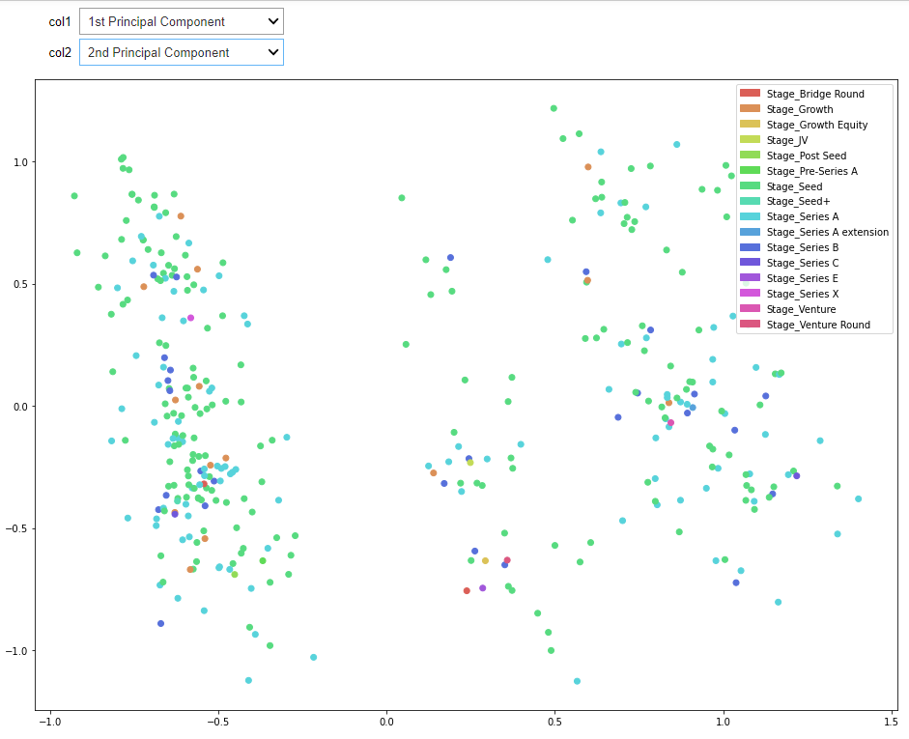
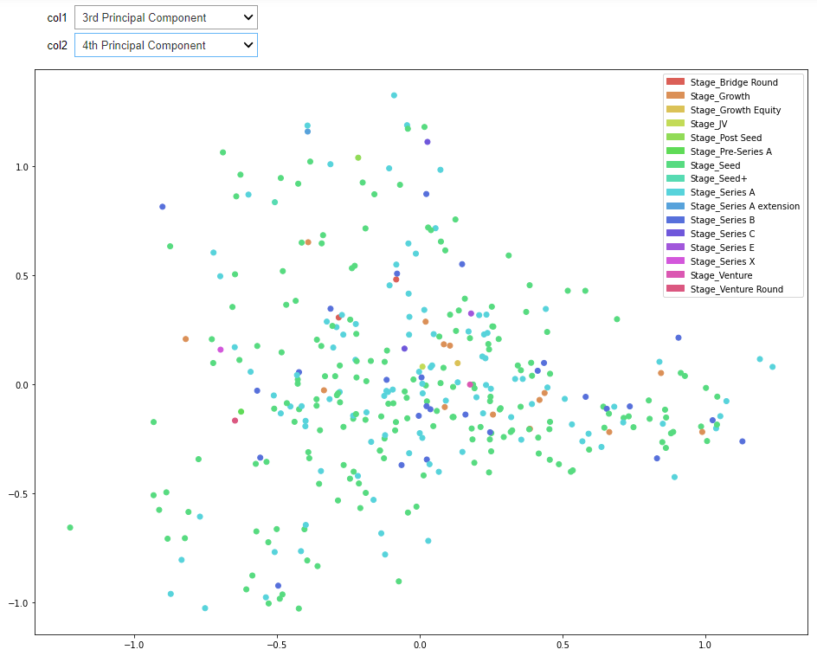
Feature Visualization
Principal Components Analysis (PCA) has been performed on the One-hot encoded Data with 5 principal components
Principal Components are Visualized using a Scatter Matrix

Slide 6
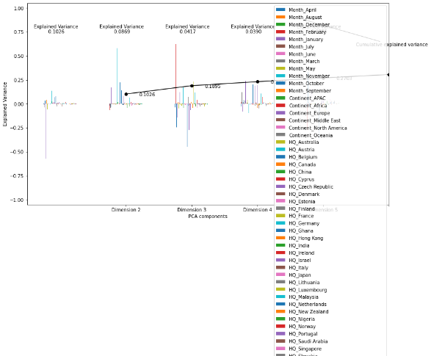
Feature Visualization…
Dimension 1 with Explained Variance Ratio = 0.1026
Dimension 2 with Explained Variance Ratio = 0.0869
And so on..
Cumulative Sum of Explained Variance Ratios is plotted to show the variation
Min and Max Facets of PCA Dimensions are reported

Slide 7
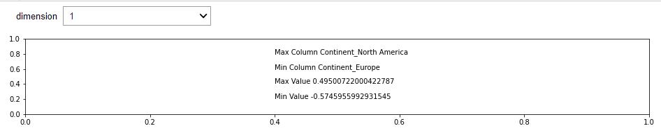
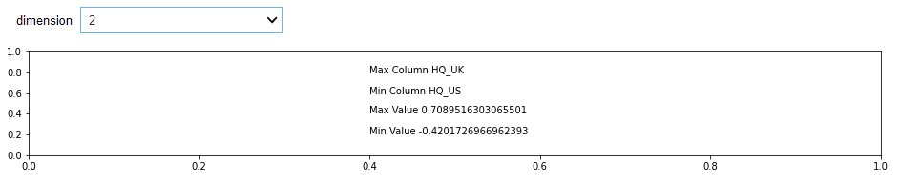
Feature Visualization…
The results of PCA Analysis is expressed as Components
The Facets of Analysis: Components with positive and negative Influence are Reported

Slide 8
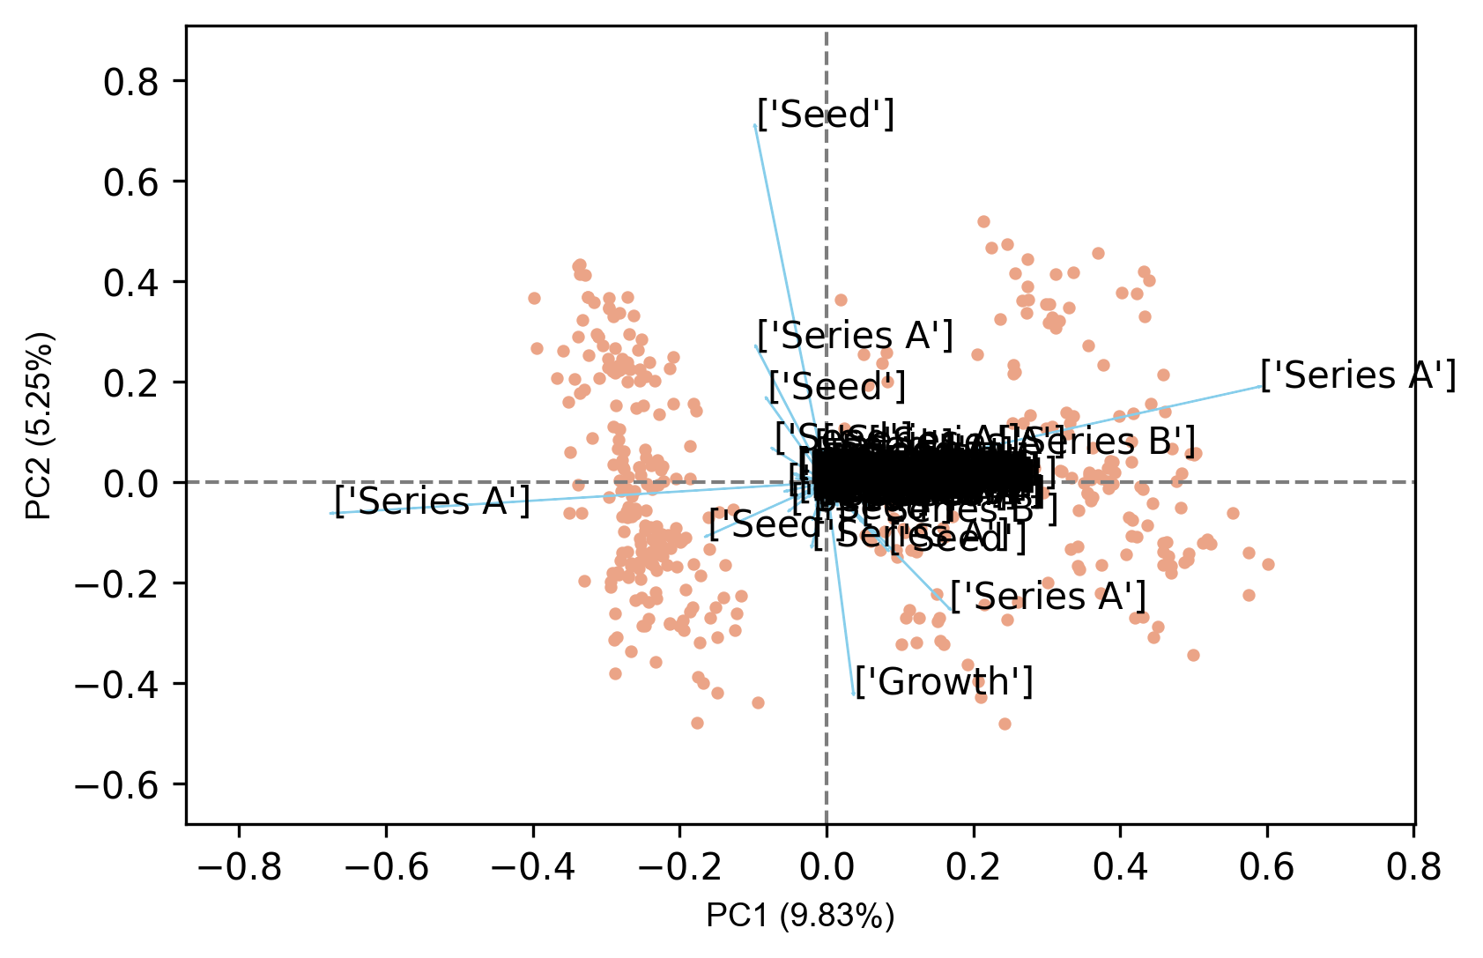
Feature Visualization…
Continent_Europe and Continent_North America act against each other
Biplot of PCA Components:
Showing
Directions of the PCA components
Scatter plot of 1 vs 2

Slide 9
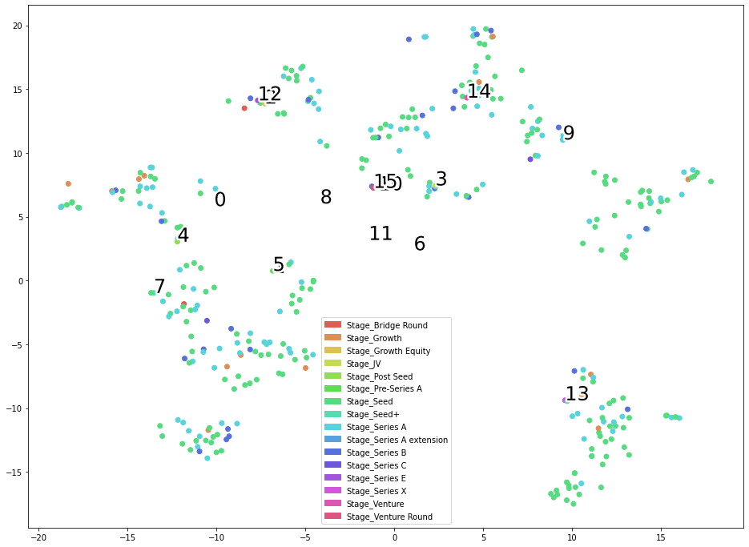
Feature Visualization…
TSNE plot to understand the distribution of the PCA components in TSNE embedding
We can observe the Seed Funding is distributed across the various clusters, which are having multiple Stage Classes
Series A has also been found to be distributed across various clusters of TSNE

Slide 10
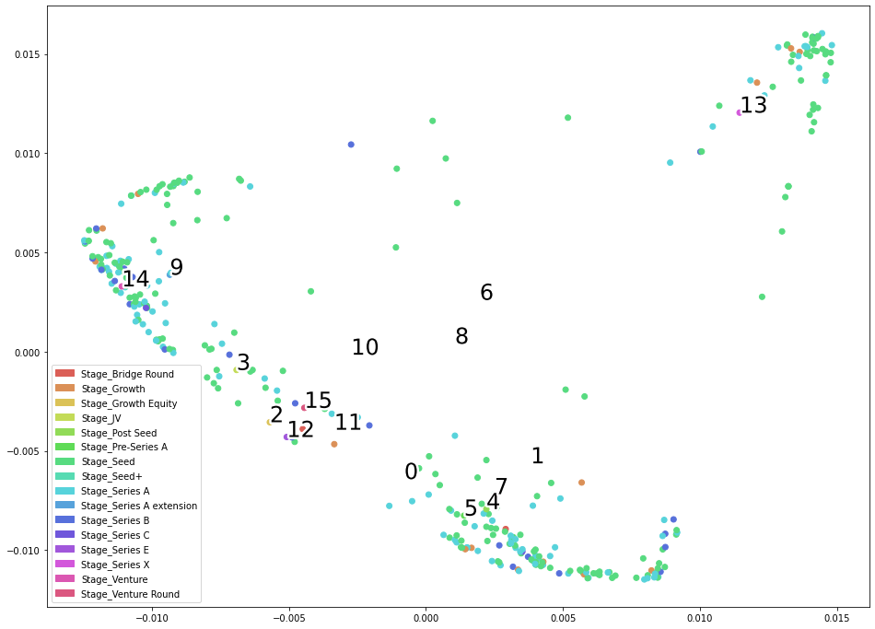
Feature Visualization…
SpectralEmbedding plot to understand the distribution of data classed by the Funding Stage attribute
The model visualization is giving us a nice Embedding when the features are PCA transformed
The Seed Funding stage is mostly in the peripheral area looking to form the boundary
This indicates the Spacing between certain groups of funding allocations and the continuity between the allocations mostly by Seed Funding and Series A Funding

Slide 11
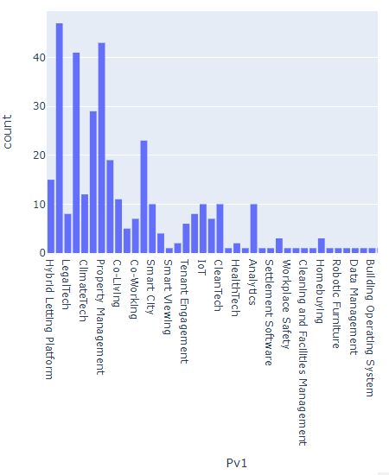
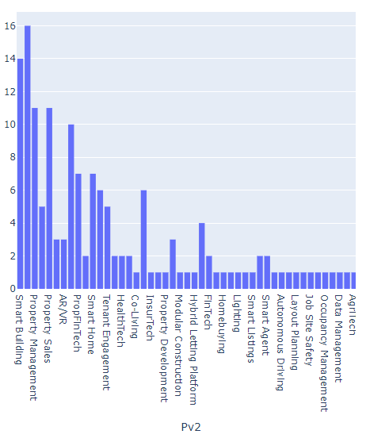
Distribution of Features

Slide 12
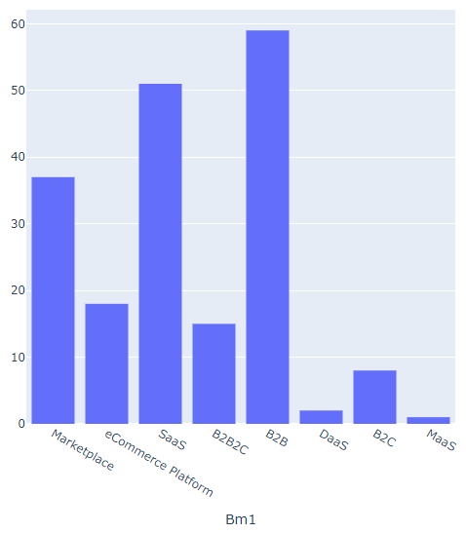
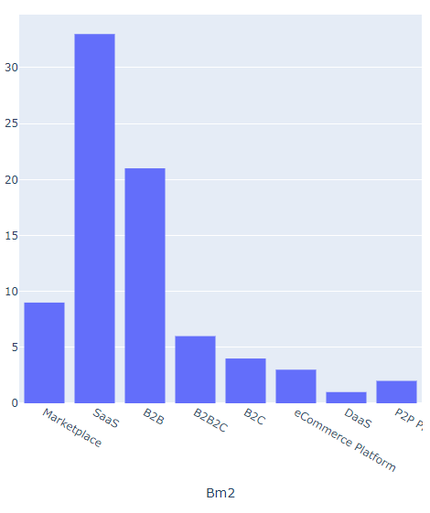
Distribution of Features…

Slide 13
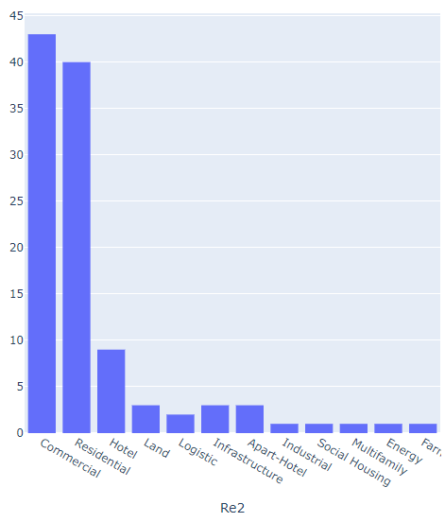
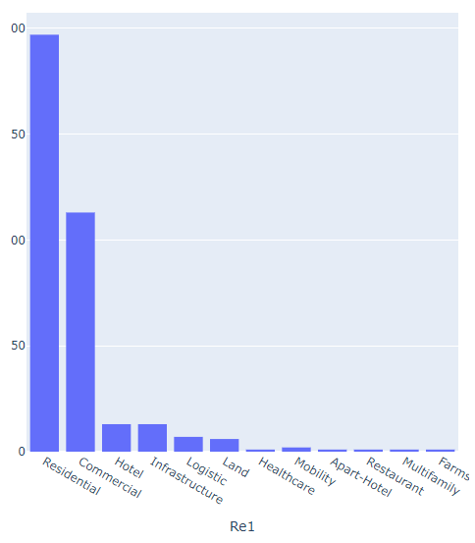
Distribution of Features…

Slide 14
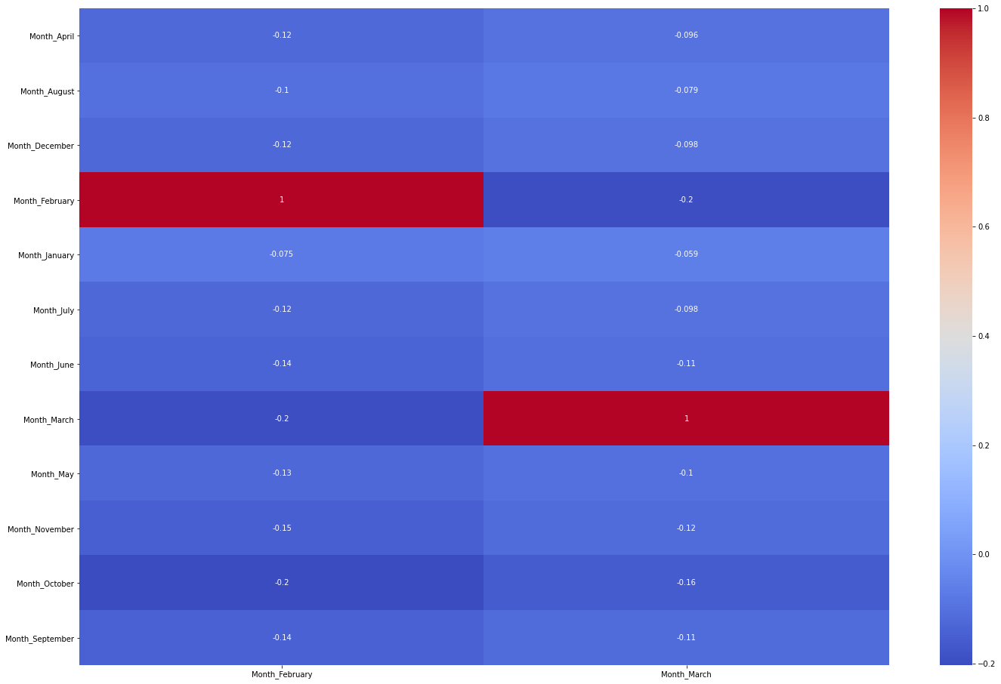
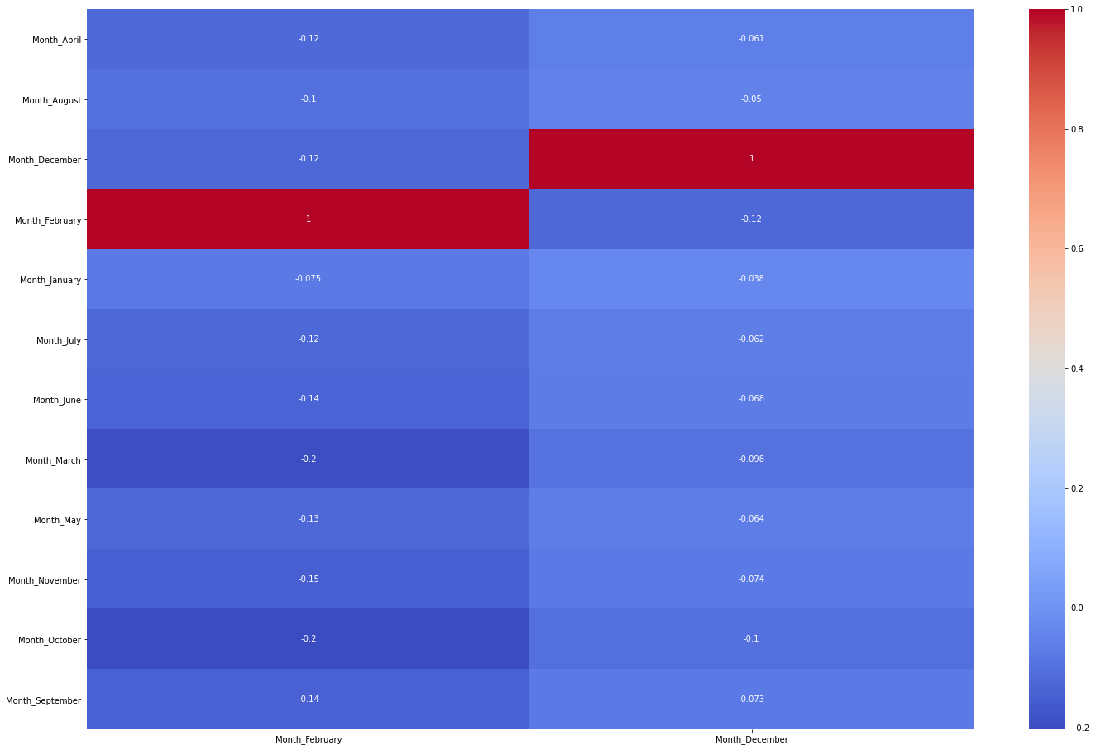
Correlation Plot
February, March and December are having equally weighed PCA Component Bars in bar plot, their correlation are also relatively higher

Slide 15
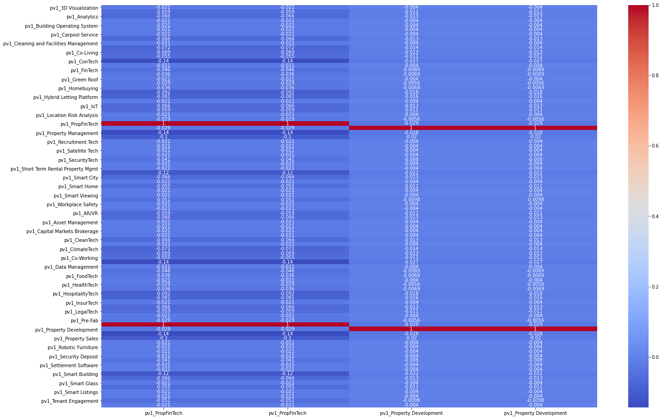
Correlation Plot…
pv1_PropFinTech,
pv1_Property Management,
pv1_ConTech
Are correlated to each other
They are also equally weighed in PCA transformation in First Dimension

Slide 16
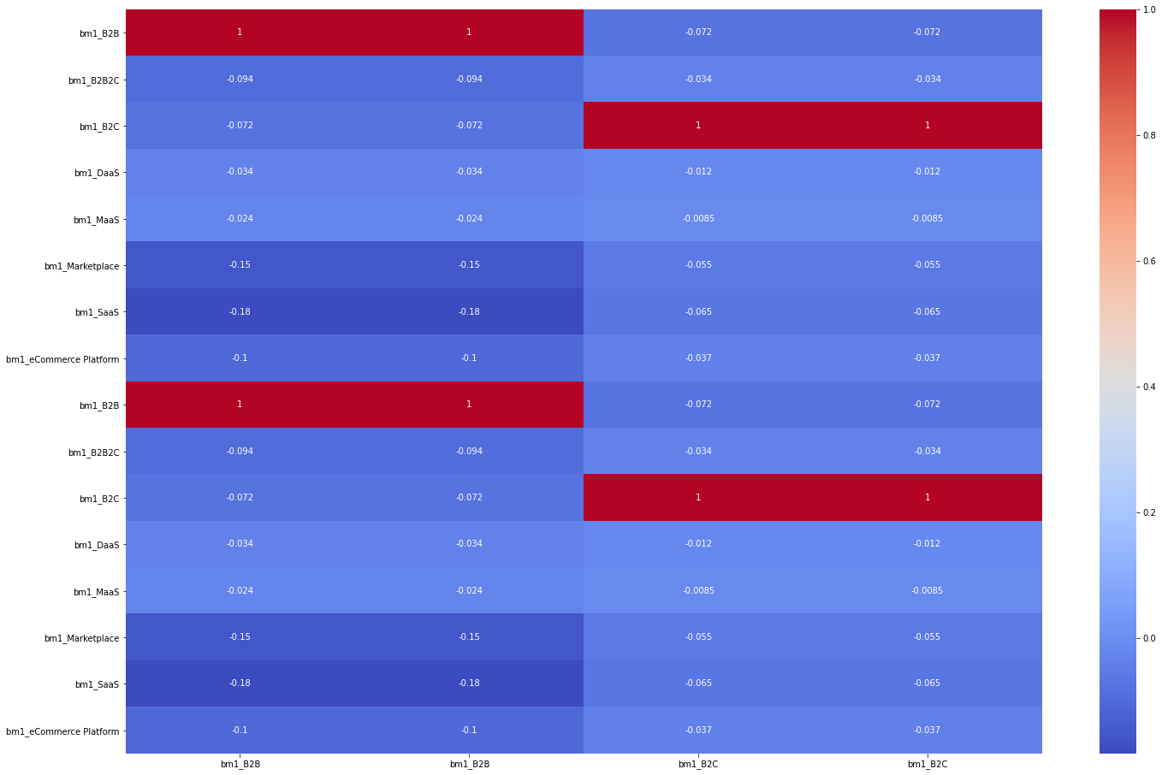
Correlation Plot…
Marketplace vs B2B vs SaaS are highly correlated
In PCA, B2B has a higher value in dimensions 1 and 2 indicating they behave differently and is possibly a clustering concern.

Slide 17
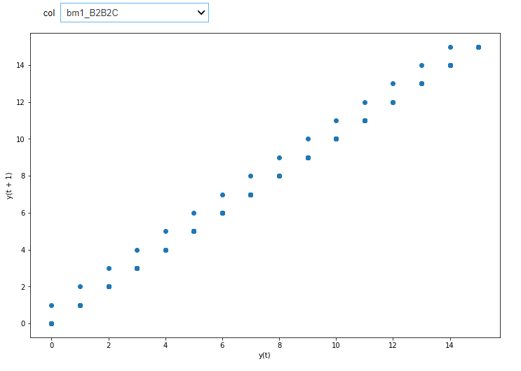
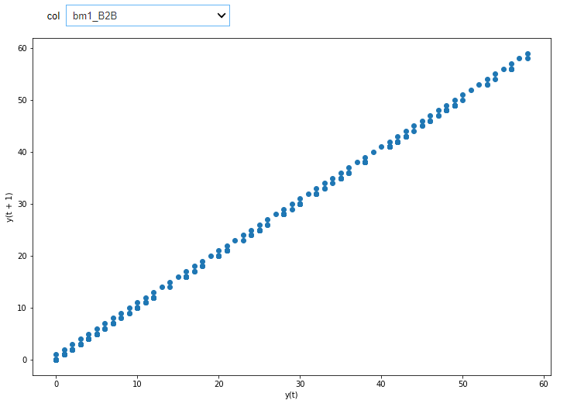
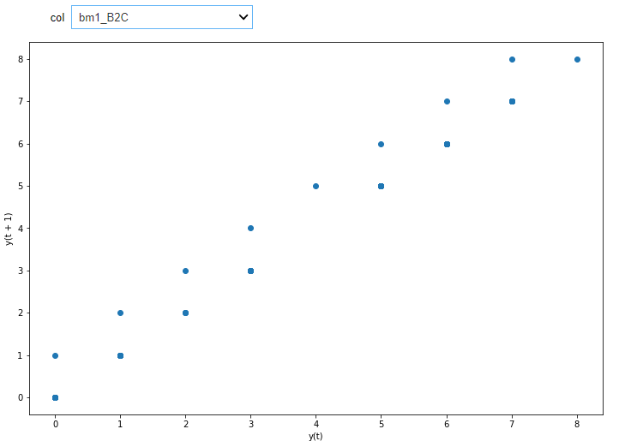
Lag Plot
B2B2C trends
B2C trends
B2B trends

Slide 18
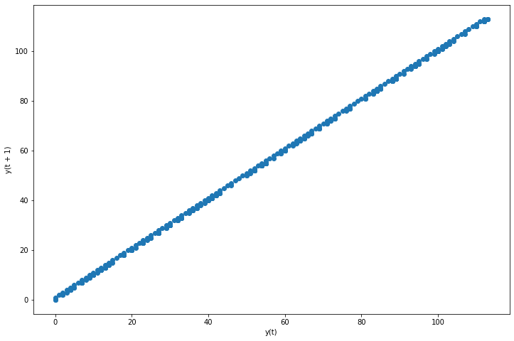
Nature of Data
The data is a time-series data which is known from the lag plot
A Cumulative Sum is taken to project the data from Sl. No. 1 to Sl. No. 373
Here, re1_Commercial is a frequently occurring value within RE

Slide 19
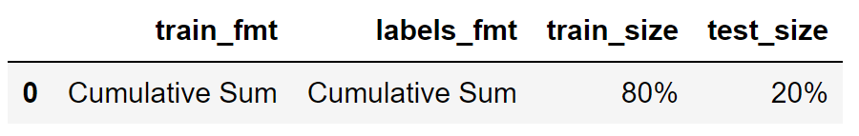
Time-series Data – Feasibility Check
Options for Prediction of Stage Attribute:
Prediction by Auto Correlation (ARIMA) but ARIMA requires continuous data which misses key class, hence infeasible because data is not enough
Only 10 classes are available when the dataset is split sequentially by train_size
Prediction by Multi-Layer Perceptrons because they consider hyperplane splitting
Prediction by Support Vector Machines, by Kernel Trick

Slide 20
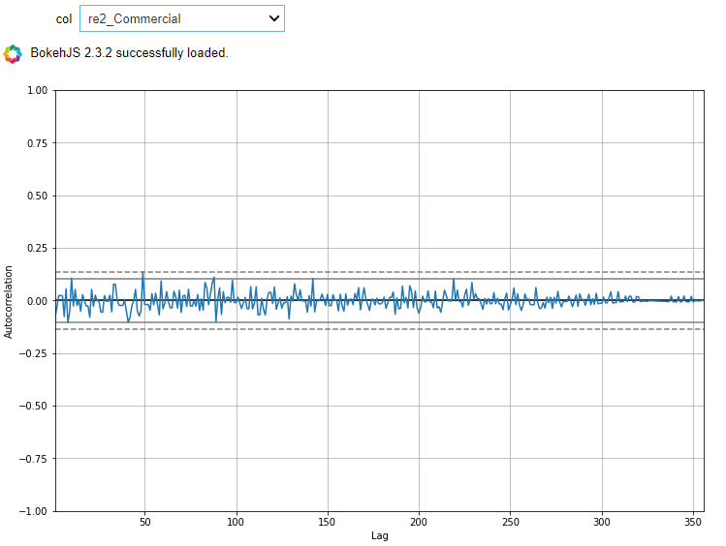
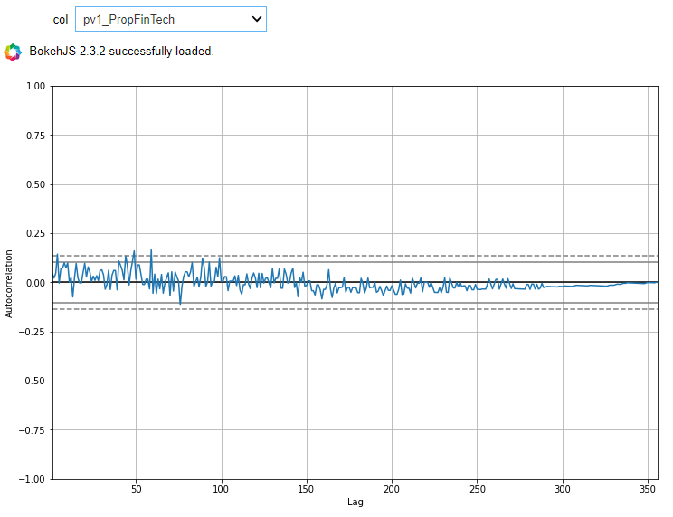
Autocorrelation Plot

Slide 21
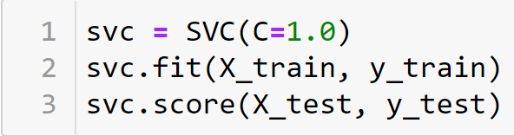
Multi-Layer Perceptrons and SVM
Model_Prediction_Score = 0.90937
Accuracy_Score = 0.51340
Accuracy_Score = 0.513889

Slide 22
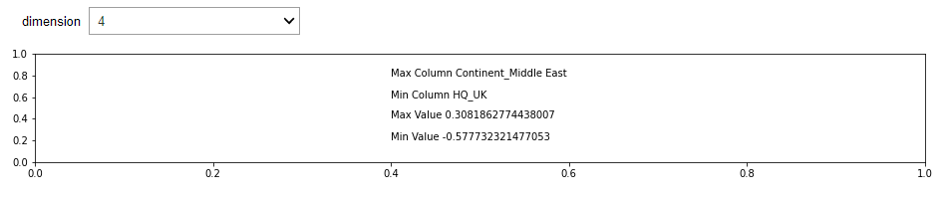
Possible Suggestions
Allocation Efficiency Evaluation by Metadata through Slacks-based Measure or Regular DEA (Data Envelopment Analysis)
We get the 4th Dimension to have Max and Min columns filled by HQ attribute

Slide 23
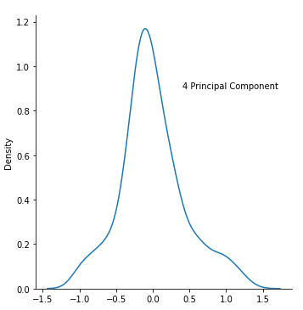
Best Fit Distribution
In order to assume our Decision Making Units (DMUs) coming from a distribution, let us find out how the 4th Principal Component is Arranged.
We use Akaike Information Criterion (AIC) to consider the smallest and find closest match to the given distribution of 4th Principal Component

Slide 24
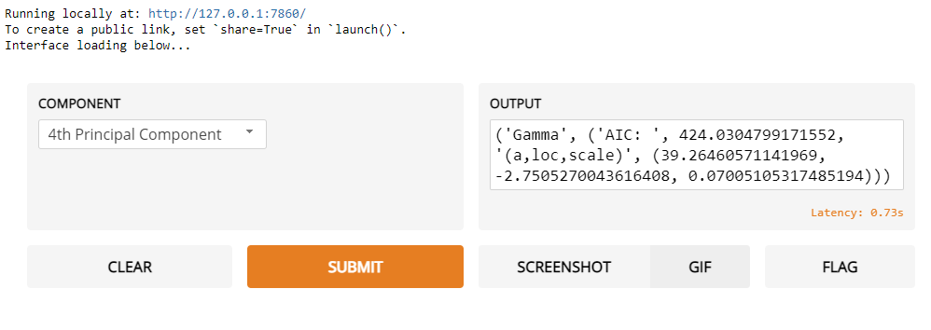
Best Fit Distribution…
We get a Gamma Distribution for the 4th Principal Component, with
AIC = 424.0305
a = 39.2646, loc = -2.7505, scale = 0.07005

Slide 25
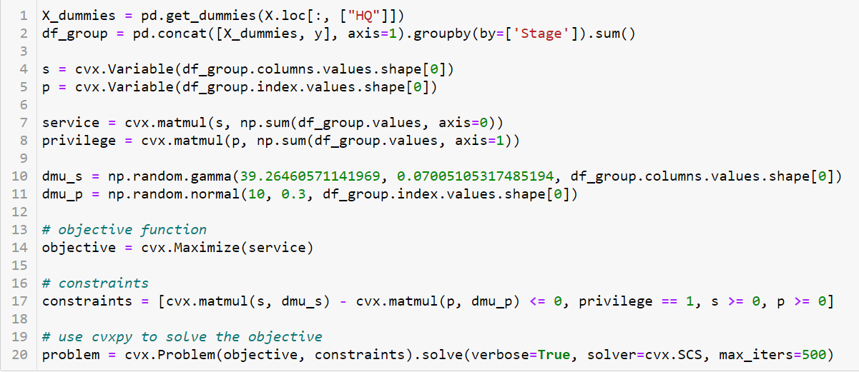
A DEA Problem

Slide 26
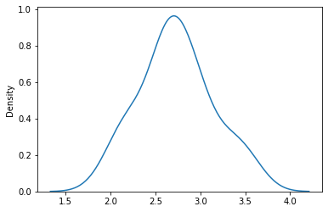
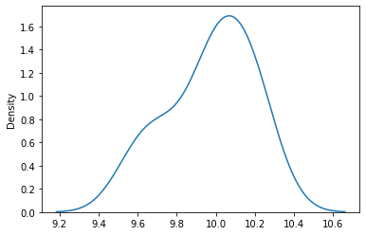
A DEA Problem…
Gamma Distribution for “HQ”
Normal Distribution for “Stage”

Slide 27
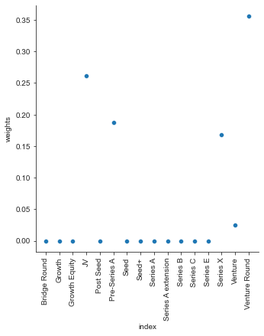
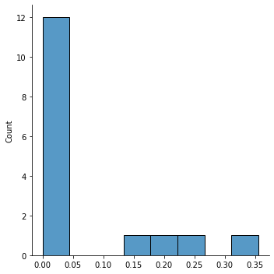
A DEA Problem…
Attribute = ‘Stage’

Slide 28
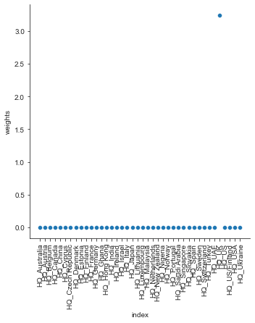
A DEA Problem…
With the given assumptions, HQ_UK has been found to have the largest value in order to optimize the problem of maximizing delivery to HQ in a hypothetical data entry or allocation process

Slide 29
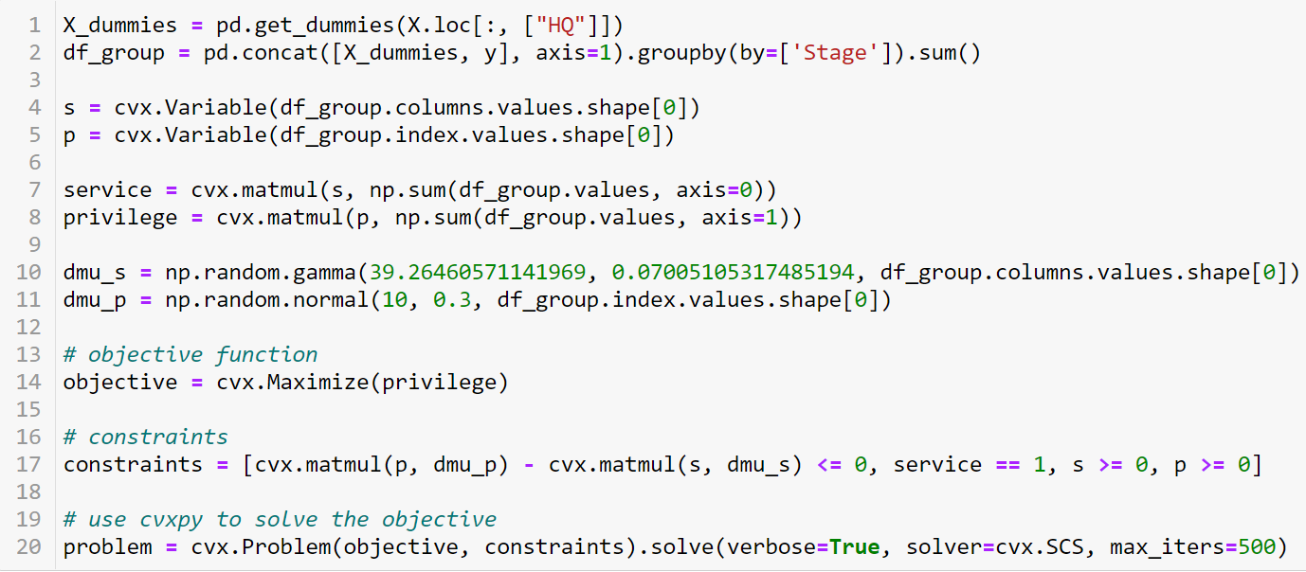
A DEA Problem…
Switching to optimizing the classification problem by Stage through HQ_UK

Slide 30
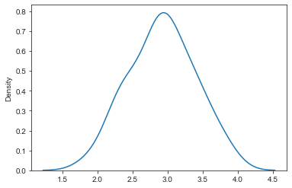
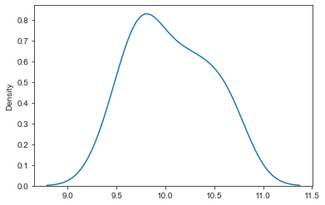
A DEA Problem…
Gamma Distribution for “HQ”
Normal Distribution for “Stage”

Slide 31
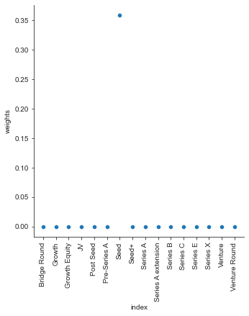
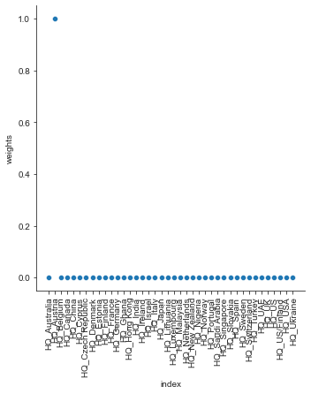
A DEA Problem…
In optimizing the classification by the Stage Attribute, the output domain is showing large value for Seed Funding Stage and HQ_Austria is showing the largest value for the input domain

Slide 32
Suggestions of Causality…
Continent_Europe and Continent_North America have been actively maintained, hence they posses min and max values respectively in PCA transformation in 1st Principal Component in opposite directions
HQ_US and HQ_UK have been actively maintained, hence they possess min and max values respectively in PCA transformation in 2nd Principal Component, also in opposite directions
Seed Funding and Series Funding are distributed across the dataset as per the TSNE Embedding
The data distribution shows a continuity in Seed Funding allocations and a wide spacing between certain groups of funding as per SpectralEmbedding

Slide 33
Suggestions of Causality…
Month_February, Month_March and Month_December show a high correlation among each other at the Funding Allocation

Slide 34
Suggestions of Causality…
The Correlation of the top Proptech Vertical Attributes behaves in a similar fashion to the Eigen Value Problem or PCA Analysis, where the component axes have been shown
The Correlation of top Business Model Attributes behaves differently to the PCA transformation, indicating they are not characteristic of core decision making whereas verticals are
The Lag plot indicates Time-series and Frequency of events occurring for our attributes or columns
The DEA Problem taken into consideration makes the HQ_UK and Stage_Seed a standing out problem due to the input-output optimization

Slide 35
Conclusion
The obtained DEA weights may be added as another feature for the dataset along with the Stage attribute and then a clustering may be performed
Alternatively, the obtained DEA weights may be added as another feature for the dataset with the Stage attribute as the training label for model consistency
The above can be explained using SHAP Feature explainer
External References:
Diabetes regression with scikit-learn — SHAP latest documentation
How to calculate feature importances from a DEA model | by Aswin Vijayakumar | Analytics Vidhya | Medium

